Slide 1

Information & Communication Technologies (ICT)
Omer Qureshi
Video Surveillance Lab (VSL)
omerqureshi.vsl@nu.edu.pk

Slide 2
About YOU
Let’s talk!
A few things which can be shared with us:
Name
Interests
3) Intermediate/A level? School / College
4) Was SE your first choice? If not, what was?
5) What do you want to do after your BS?

Slide 3
About the Instructor
BBA (2008) – Business Administration from IoBM Karachi
MA (2017) – Economics from University of San Francisco (USA)
MS (2022) – Data Science from FAST NUCES Karachi
Over a decade of Banking experience mainly in the field of Business Intelligence

Slide 4
Important soft skills
Typing
Reading
Presentation and communication

Slide 5
Semester System
Early impressions matter
Your past success will not determine the future
Do not rely fully on the instructors
Seek outside resources such as YouTube and Coursera

Slide 6
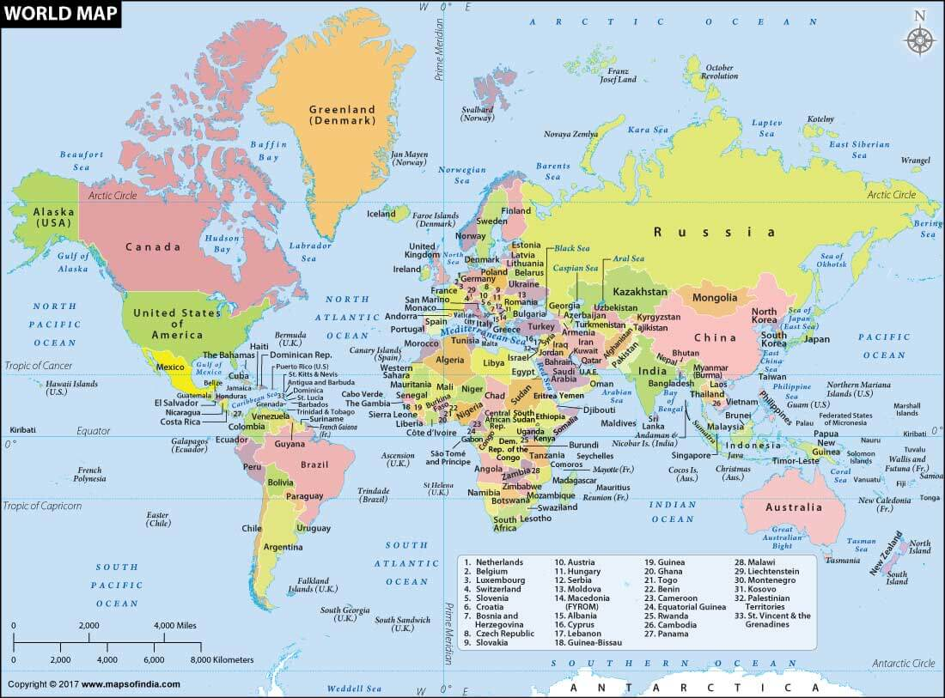
Key point to remember
DIFFERENTIATE
COMPETITION IS WITH THE WORLD

Slide 7
Marks distribution
1) 30 Mid (will be held in 9th week of semester)
2) 20 Sessional - assignments, lab tasks
3) 50 Final Exam ( will be held on 17th week of semester, along with Theory final exams)

Slide 8
Rules of the Game
Discipline
0 tolerance for plagiarism
Attendance within the first ten minutes of class
Get a notebook and make notes by hand
Save the workbooks and practice at home – SAME DAY

Slide 9
Course Outline
START
Word, Excel, Windows/Linux etc., Basic Definitions & Concepts, Hardware: Computer Systems & Components. Storage Devices, Number Systems, Software: Operating Systems, Programming and Application Software, Introduction to Programming,
MID EXAM
Databases and Information Systems, Networks, Data Communication, The Internet, Browsers and Search Engines, The Internet: Email, Collaborative Computing and Social Networking, The Internet: E-Commerce, IT Security and other issues PowerPoint, etc.

